Slide 1
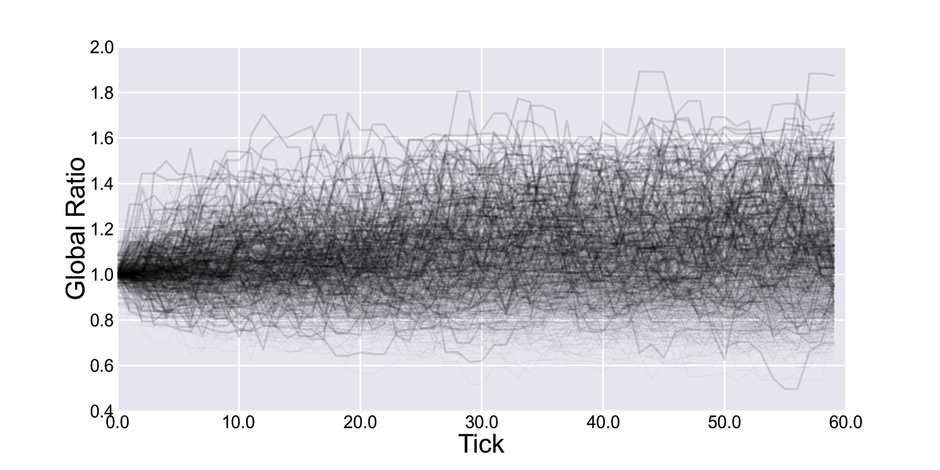
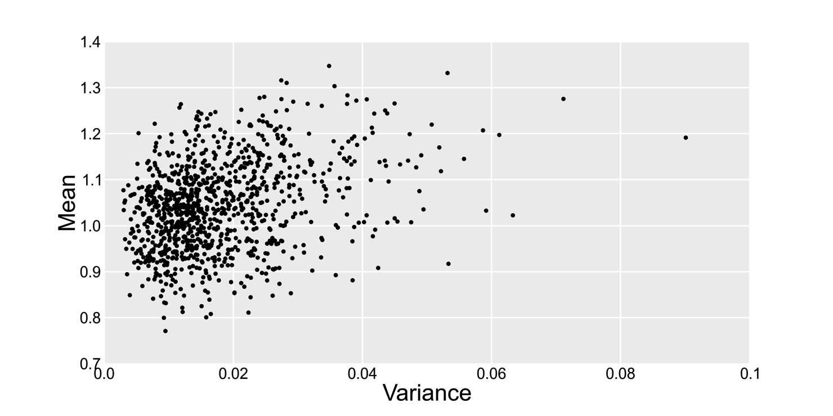
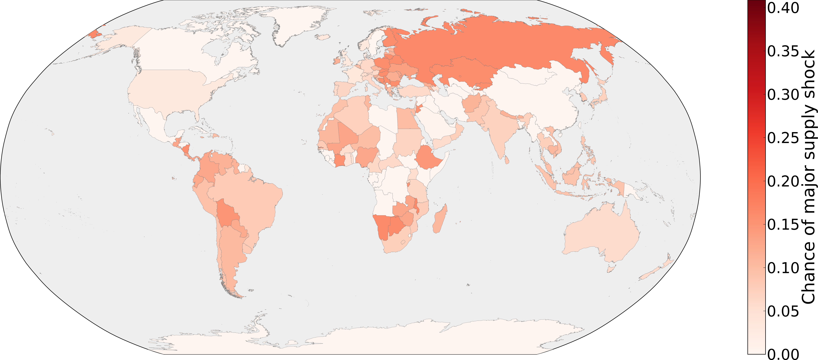
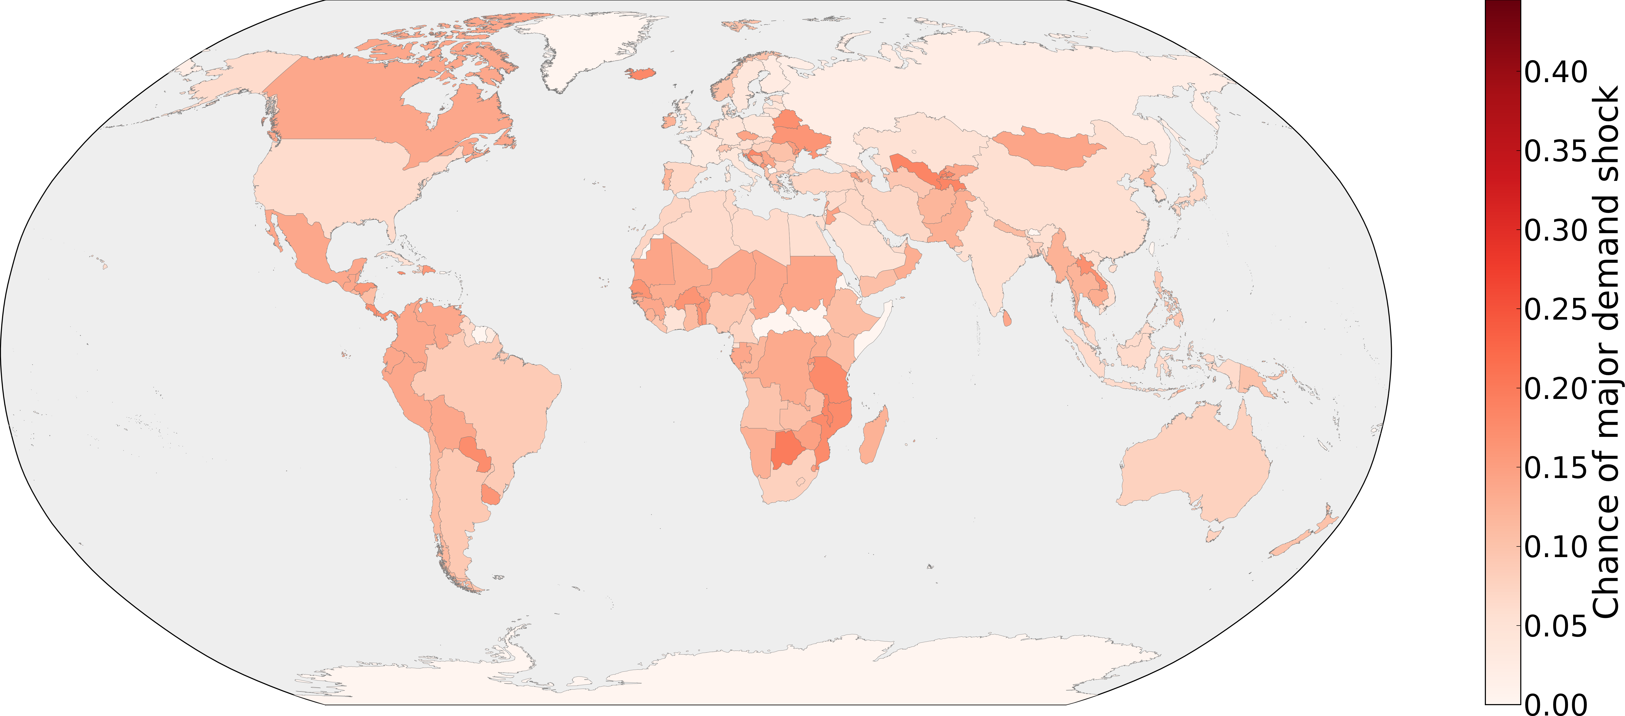
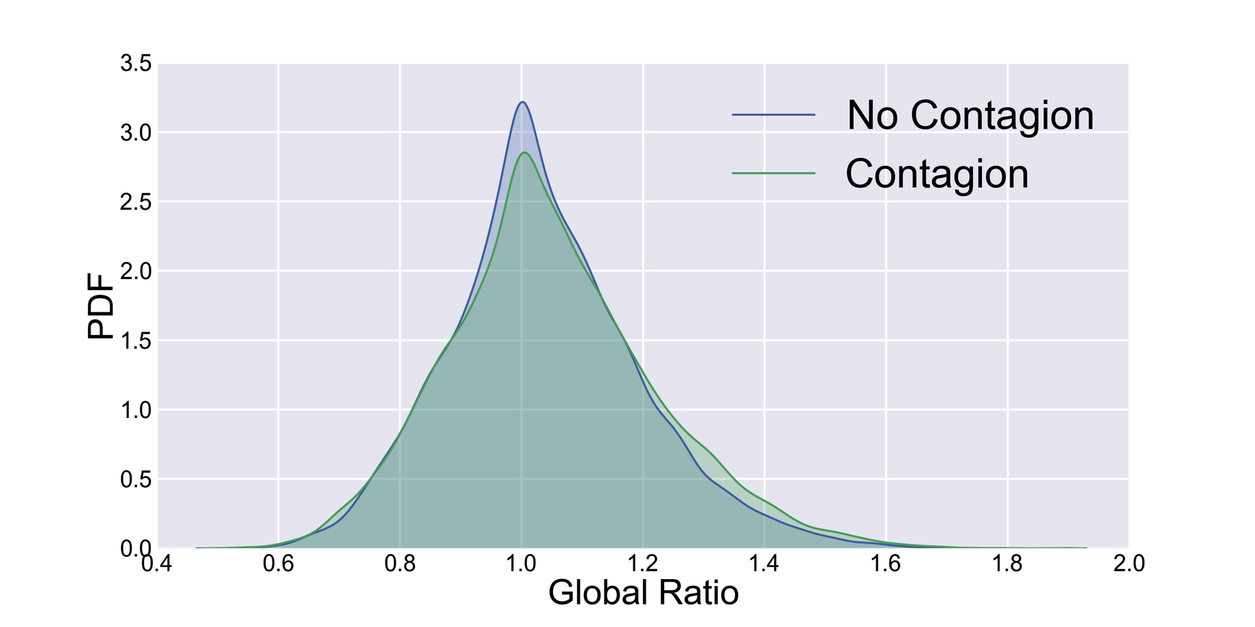

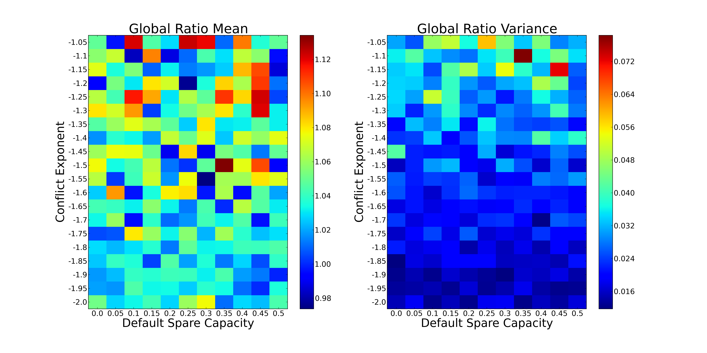
Simulating International Energy Security
David Masad
Department of Computational Social Science
George Mason University
dmasad@gmu.edu
for Advanced Study
Introduction
Results
Discussion
Energy Security: “The uninterrupted availability of energy sources at an affordable price” (IEA)
Greatest risk to energy security are supply shocks.
All oil supply shocks since 1970 driven by conflicts or crises (e.g. Gulf War, Venezuela general strike).
Quantitative risk assessments (e.g. IEA’s MOSES) are static, and look at average risks.
Project Objective: Create dynamic, empirically-grounded simulation of energy security, and use it to estimate global and country-level risks.
Model Analysis
Estimated Energy Security, By Run
Extreme oil shocks unlikely, but possible.
Distinguish between two types of insecurity:
Short-term fluctuations in secure supplies
Long-term reduction in availability of secure supplies
Diverse trade partners are important, particularly if conflict contagion is a risk.
Consumption of domestic production significantly reduces risk of supply shocks, even in the absence of energy independence.
Countries at greatest supply risk are in the Global South, Eastern Europe.
Greatest demand risk in the Americas.
Conflict contagion does increase risks
Assistance does not, suggesting that spare capacity may not be able to mitigate severe crises.
Significant data requirements even for relatively simple model.
1,000 model runs
60 ticks per run (5 simulated years).
Statistics Collected Per Tick
Supply Ratio: the fraction of each country’s total demand met by secure supplies.
Demand Ratio: The fraction of each country’s exports going to secure importers.
The Global Ratio of total secure demand to total secure supplies, across all countries.
Global Ratio Traces – All Runs
Global Ratio Variance and Mean
Model Description
Majority of results within narrow, stable band
Most shocks are short-duration spikes
Long-duration crises can result in stable new baselines.
Little correlation between variance and mean of each run
The model consists of country agents, linked geographically by mutual borders and via a crude oil trade network.
Each country has a set supply of, and demand for, crude oil.
Each tick:
Countries enter crisis at random, with fixed probabilities.
Crisis lengths are drawn from a power law distribution.
If conflict contagion is enabled, crises may spread from a country to its neighbors.
The oil exported from, and imported to, countries in crisis is considered to be insecure.
If Assistance enabled, if a country is experiencing a supply shock, its trade partners that are not in crisis may temporarily increase their production. This increases their exports to all their trade partners as well.
Estimated Country-Level Risks
For each country, I compute the fraction of run-months in which the country experiences a supply or demand crisis, defined as a supply ratio ≥2 or a demand ratio ≤0.5.
Future Work
Incorporate additional energy security factors:
Oil reserves
Refining capabilities
Natural gas
Shipment routes
Improve agent decisionmaking
More sophisticated assistance model
Allow agents to add and remove trade relationships
Changing supply and demand
Historic data for backtesting
Future forecasts
Validate against historic energy shocks
Supply Risk
Demand Risk
Effects of Contagion and Assistance
Sensitivity Analysis
Data Sources
In order to determine the effect of the conflict contagion and assistance mechanisms, I turn each on and off and examine the resulting distribution of the global ratios across all run-months.
Parameters varied:
Conflict duration coefficient: -1.05 to 2.00
Default spare production capacity: 0% to50%
Measure mean and variance of Global Ratio at each.
Results robust to different parameter values
Oil trade network: UN COMTRADE 2012 crude petroleum trade.
Demand: total imports + estimates of consumption of domestic production.
Supply: Total exports.
Spare capacity: media and SME estimates. Defaults to 10% of total production.
Crisis probability: Economist Intelligence Unit Political Stability Index.
Crisis duration: calibrated from Armed Conflict Dataset, Social Conflict in Africa Database. Default coefficient: -1.37.
Effect of Assistance
Effect of Conflict Contagion
References
Cullen S. Hendrix, and Idean Salehyan. 2013. Social Conflict in Africa Database (SCAD). Economist Intelligence Unit. 2013. “Social Unrest.”
International Energy Agency (2013). Topic: Energy security.
Jewell, Jessica, and International Energy Agency. 2011. “The IEA Model of Short-Term Energy Security”. International Energy Agency.
Kilian, Lutz. 2008. “Exogenous Oil Supply Shocks: How Big Are They and How Much Do They Matter for the U.S. Economy?” Review of Economics and Statistics 90 (2): 216–40.
Themnér, Lotta, and Peter Wallensteen. 2013. “Armed Conflicts, 1946–2012.” Journal of Peace Research 50 (4): 509–21.
United Nations Statistical Division. 2013. COMTRADE.
Conflict contagion has a small but statistically significant effect
Increases the probability of extreme supply shocks.
Assistance had no statistically significant effect.
Major supply shocks driven by crises in major exporters, which cannot then assist.

